Slide 1
Feature Engineering based on CNN
风险管理部
Jerry Cheng

Slide 2
Project Background
Objective: Using CNNs to extract new features from loan users to improve risk model performance
Approach: Convolutional Neural Network (CNN)
Dataset: CelebA
Notes:
项目背景 (Project Background)
目的 (Objective)
数据集 (Dataset) 香港中文大学发布

Slide 3
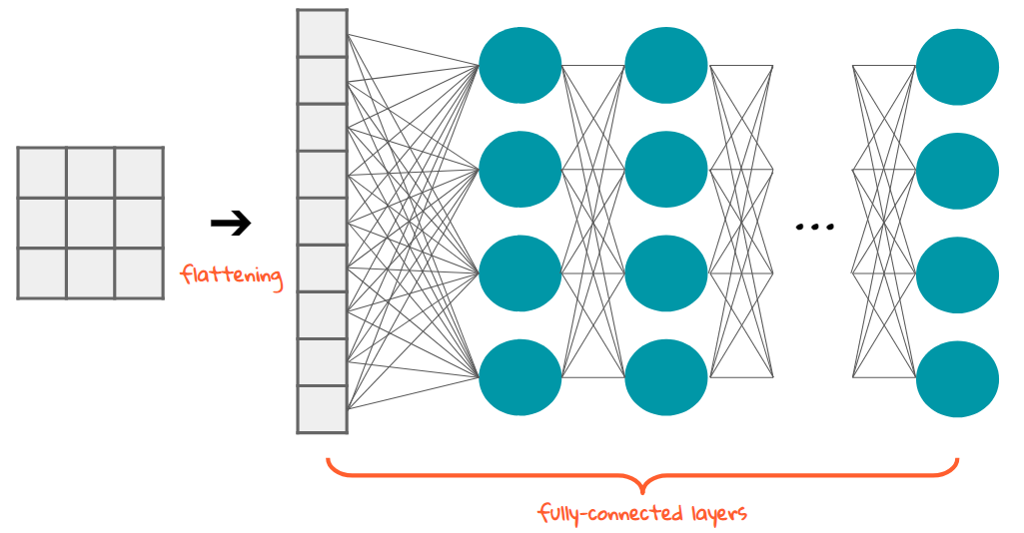

CNN Advantages and Structure
Used for image classification tasks
Representation learning
Retains image spatial information (no flattening)
Less parameters than fully connected net
Notes:
卷积神经网络结构
Layer levels and abstraction
Representation learning - allows a system to automatically discover the representations needed for feature detection or classification from raw data. This replaces （手工）manual feature engineering and allows a machine to both learn the features and use them to perform a specific task.
不需要手工设计，里面是black box
Less parameters because locally connected, parameter sharing

Slide 4

Convolution layer
Kernel moves across input data
Creates new features through convolution operation(output feature maps)
Multiple kernels used
Notes:
卷积操作 (convolution operation)
Parameter sharing – kernel uses same weights for each operation
Locally connected – each output neuron only connected to 3 * 3 input neurons
Parameter counts FC = 25 * 9 = 225 CNN = 9
Each layer uses multiple kernels to extract different features

Slide 5

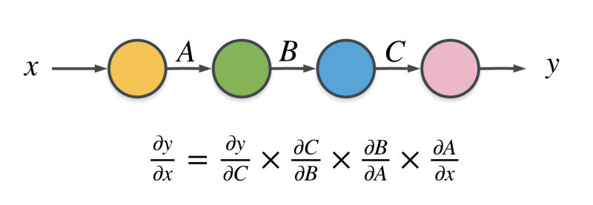
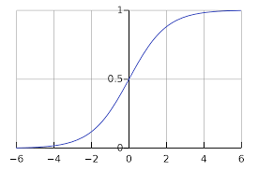
Non-linearization
Most real world patterns non-linear
ReLU used
Sigmoid function has gradient saturation and gradient vanishing (chain rule)
Notes:
真实世界的问题大多是是non linear的
需要用non linear的active function去近似
ReLU = rectified linear unit
No gradient saturation (slow training)
CNN很多层 = chain rule
Gradient vanishing = chain rule
In calculus, the chain rule is a formula to compute the derivative of a composite function.
Easier backpropagation

Slide 6

Pooling
Decreases output size which lowers computational power
Max pooling
Average pooling
Notes:
-降低输出尺寸 = 降低了参数和算力
最大值
平均值

Slide 7
Fully Connected layer
All features flattened into single 1D array
Output passed through SoftMax for probabilities
Notes:
最后有fully connected layer
Flattened不会失去空间信息
Softmax

Slide 8
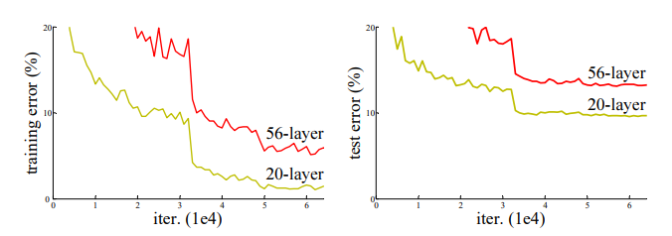
ResNet
Degradation problem in deep CNNs
Deeper CNNs start having worse performance
Gradient vanishing
Notes:
ResNet = improved CNN
Deeper plain CNNs should work better
Deeper Resnets do not perform worse

Slide 9
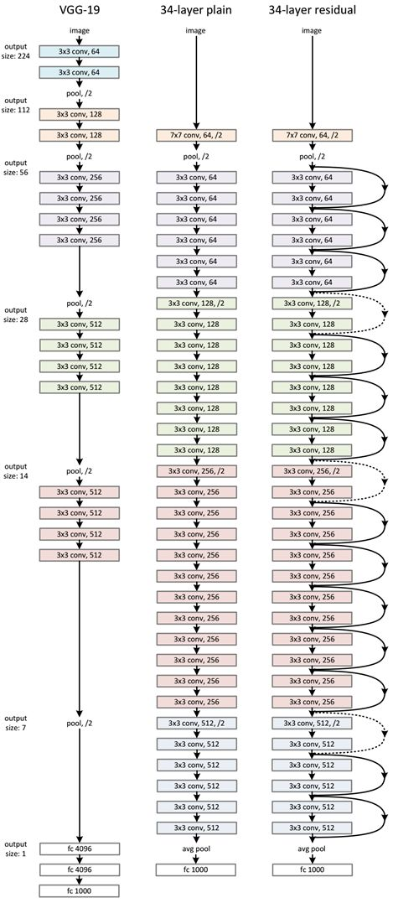
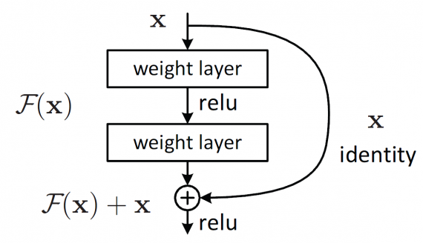
ResNet Structure
Skip connections
Eases gradient vanishing
Layers furthest away from loss still influence loss directly
Gradients for first layer partially calculated directly against loss
Notes:
- Gradient calculated directly against

Slide 10
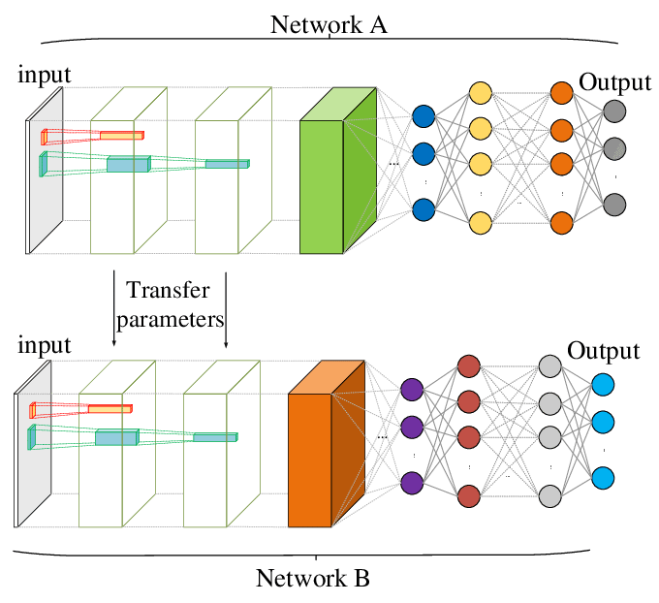
Transfer learning and Weight Initialization
Weight initialization usually done with normal distribution
Transfer learning also used
Final model used transfer learning with pretrained weights
Notes:
Pretrained weights from imagenet 1000
Model will train faster and can have better performance
Already knows color and edges

Slide 11
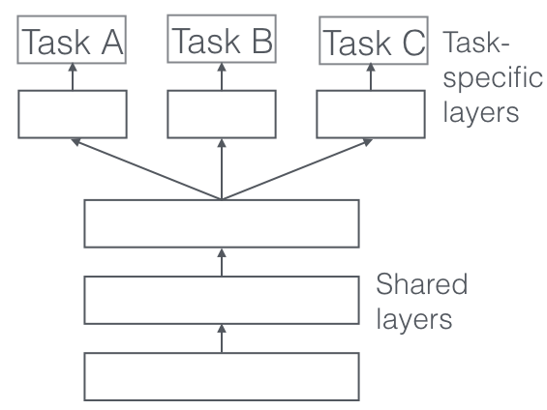
Multi-task Learning
Multiple tasks in the same net
Usual models have only one output and SoftMax
Final model used multiple task specific fully connected layers
Notes:
Usual models only have one output, the highest probability one
Face attributes not mutually exclusive
Probability of each attribute being 0 or 1

Slide 12
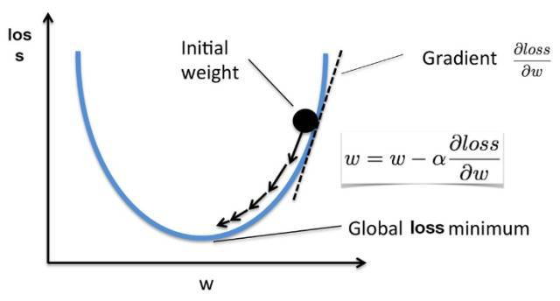
How to Train – Stochastic Gradient Descent
Forward propagation
Model output calculated
Loss calculation
Model output compared to expected output
Backpropagation
Weight gradients calculated using chain rule
Optimization
Weight = weight – learning rate * gradient
Notes:
- Stochastic gradient descent to optimize loss function

Slide 13

Pytorch
Python based package
Developed by Facebook
Utilizes power of GPUs for tensors
Deep learning platform
Autograd module
Dynamic computation graph
Notes:
Gpu faster than cpu for tensors
动态计算图

Slide 14
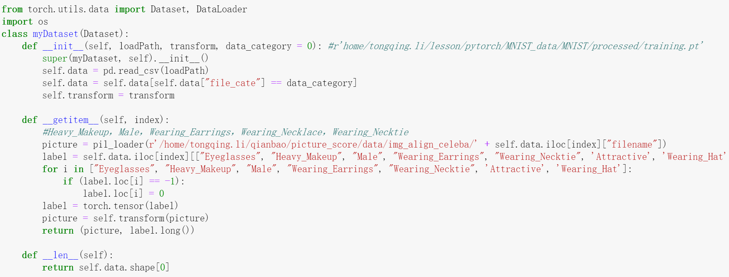
Python Implementation
myDataset – inherits map style dataset
nn.Conv2d – convolution layer
nn.MaxPool2d – max pooling
Notes:
- 继承dataset, 准备数据

Slide 15
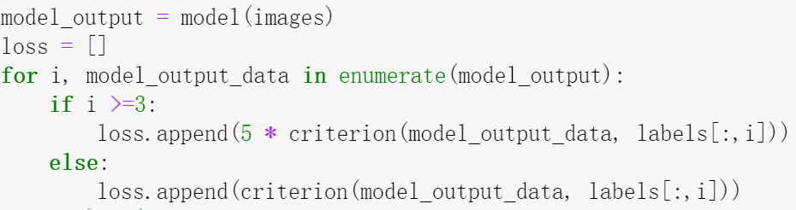
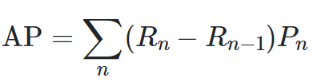
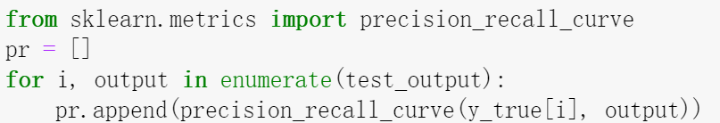
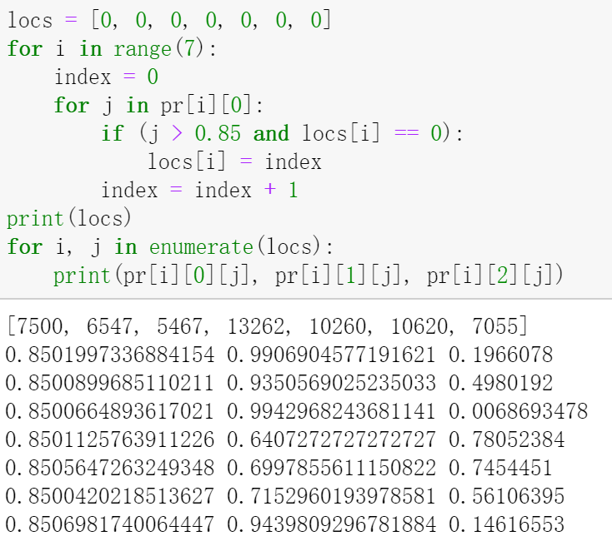
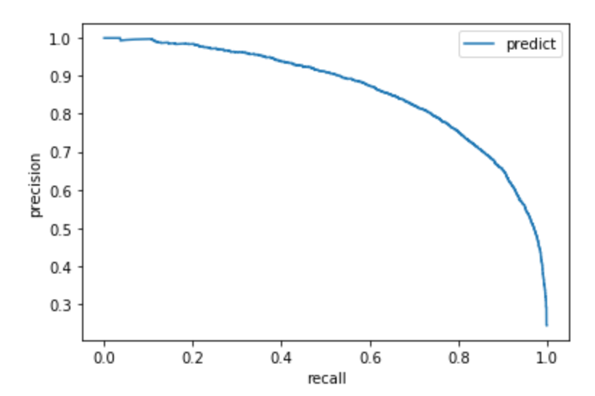
Python Implementation
Accuracy is a bad measure of model performance
Precision tp/(tp+fp)
Recall tp/(tp+fn)
Sklearn precision recall curve
Average precision score
Loss calculation
Optimization
Notes:
Loss = nn.CrossEntropyLoss()
Optimizer is SGD (stochastic gradient descent)
Evaluate = 评估
Precision = how much of the flag = 1 is actually 1
Recall = how much of the actually 1s found by model
Average precision score = area under precision recall curve = model performance

Slide 16
Experimentation
CelebA dataset
Training 162,270
Validation 20,000
Test 20,000
Resnet50 chosen
Cutoffs:
Eyeglasses 95%
Heavy Makeup 85%
Necktie 85%
Resnet50
Attribute | 95% precision | 85% precision | AP
Eyeglasses | 0.978 | 0.990 | 0.989
Heavy Makeup | 0.753 | 0.935 | 0.961
Necktie | 0.476 | 0.745 | 0.864
Resnet18
Attribute | 95% precision | 85% precision | AP
Eyeglasses | 0.979 | 0.987 | 0.988
Heavy Makeup | 0.785 | 0.938 | 0.967
Necktie | 0.445 | 0.719 | 0.871
Notes:
Recall of model at different precisions
Resnet50 chosen for better performance on necktie
Cutoffs adjusted due to low recall

Slide 17
Experimentation
Attribute | Flag = 0 | Flag = 1 | Ratio | % with attribute
Eyeglasses | 5.36% | 3.71% | 0.692 | 13.4%
Heavy Makeup | 5.16% | 3.75% | 0.725 | 1.7%
Necktie | 5.14% | 4.25% | 0.827 | 0.23%
Not enough people had heavy makeup or necktie
Eyeglasses added to old risk model using logistic regression
Flag = 0 means attribute flagged as negative
Flag = 1 means attribute flagged is positive
Metric | Original model | Modified model | Lift | Lift %
Top 10% | 19.42% | 19.72% | 0.3% | 1.54%
Top 20% | 34.77% | 35.04% | 0.27% | 0.77%
K-S | 21.67% | 22.24% | 0.57% | 2.63%
People flagged with heavy makeup 27.5% less likely to have overdue loans
People flagged with necktie 17.3% less likely to have overdue loans
People flagged with eyeglasses 30.8% less likely to have overdue loans
People in top 10% of risk levels which had overdue loans went from 19.42% to 19.72%
Top 20 % increased from 34.77 to 35.04
K-S increased from 21.67% to 22.24%,
Notes:
Percentage of people flagged as 0 or 1 with overdue loans
模型判为有eyeglasses的人的overdue rate是没有这个属性的人的百分之69,
模型判为有Heavy makeup的人的overdue rate是没有这个属性的人的百分之72
模型判为有Necktie的人的overdue rate是没有这个属性的人的百分之82
有eyeglasses的人是全部的人的13.4%

Slide 18
Conclusion
CNNs can successfully extract features to improve the risk model performance

